Slide 1
Econ 200 Module 2 Lecture 3

Slide 2
Outline
1. Supply and the Law of Supply
2. Changes in Supply
3. Equilibrium – Putting Supply and Demand Together
4. Impact of Curve Shifting on Equilibrium
5. Practice Problems
Readings: Chapter 3.4-3.7

Slide 3
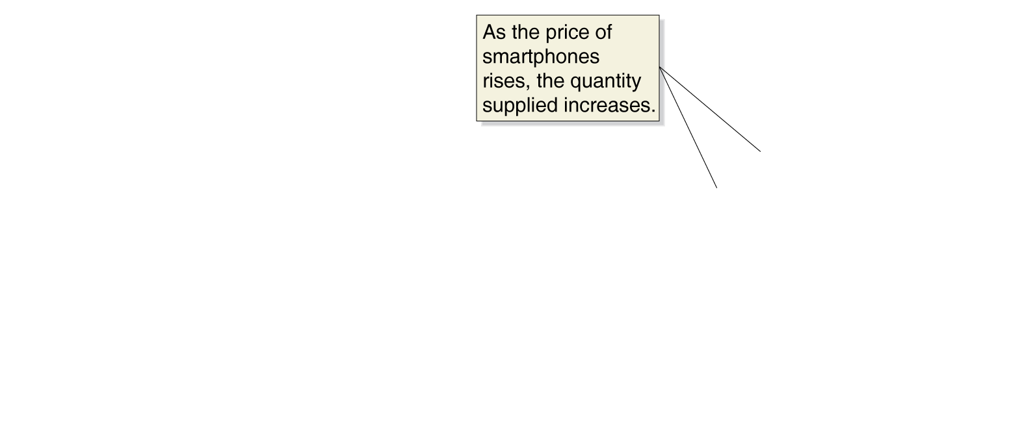
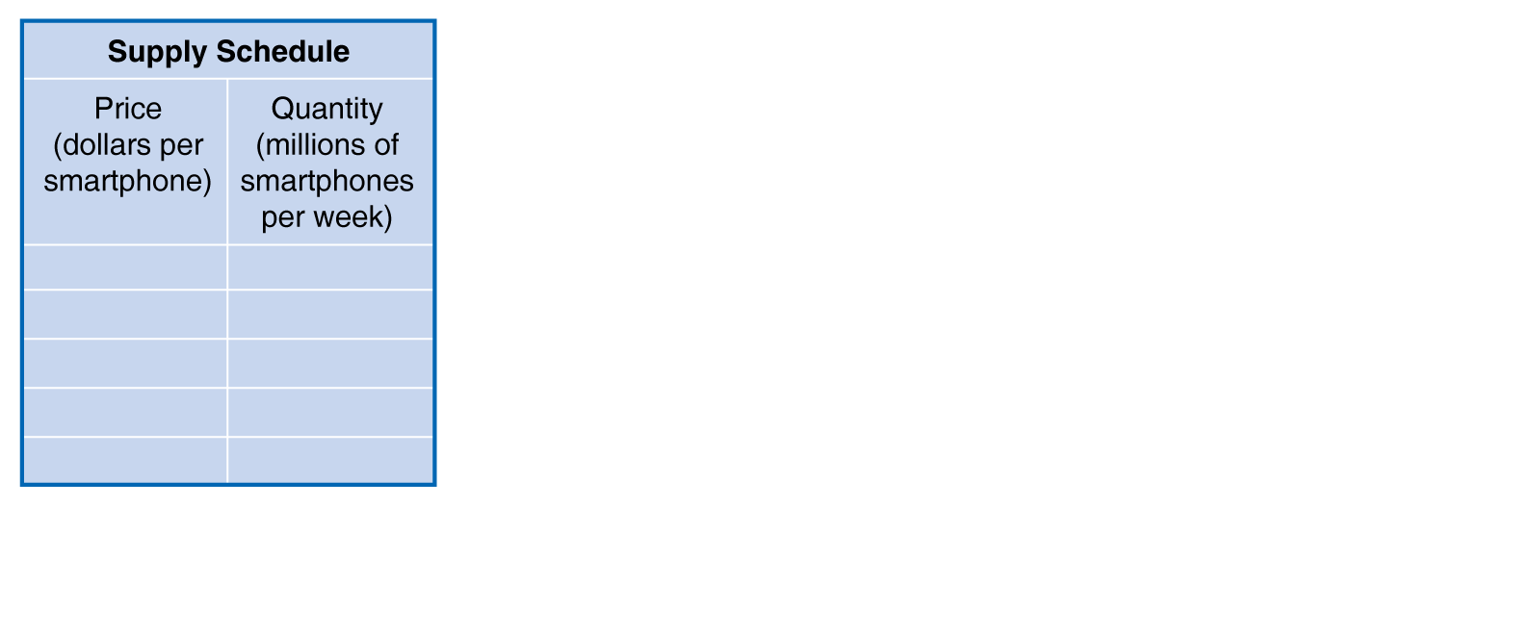
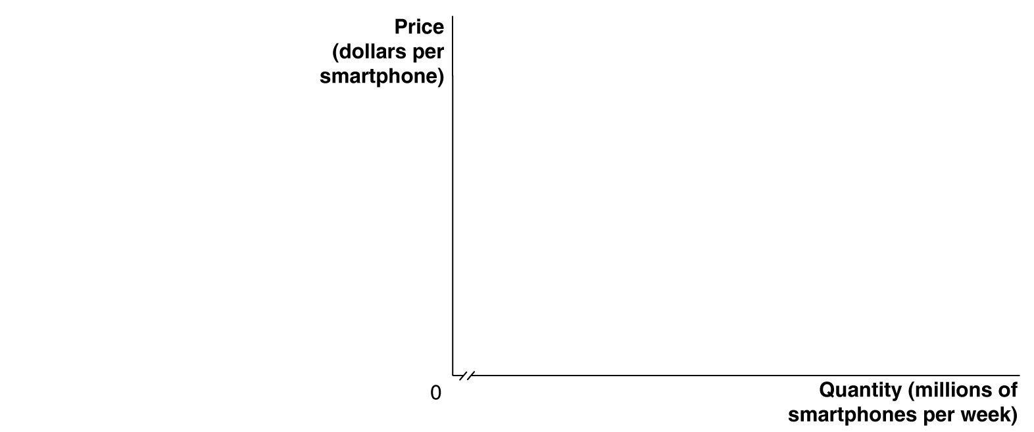
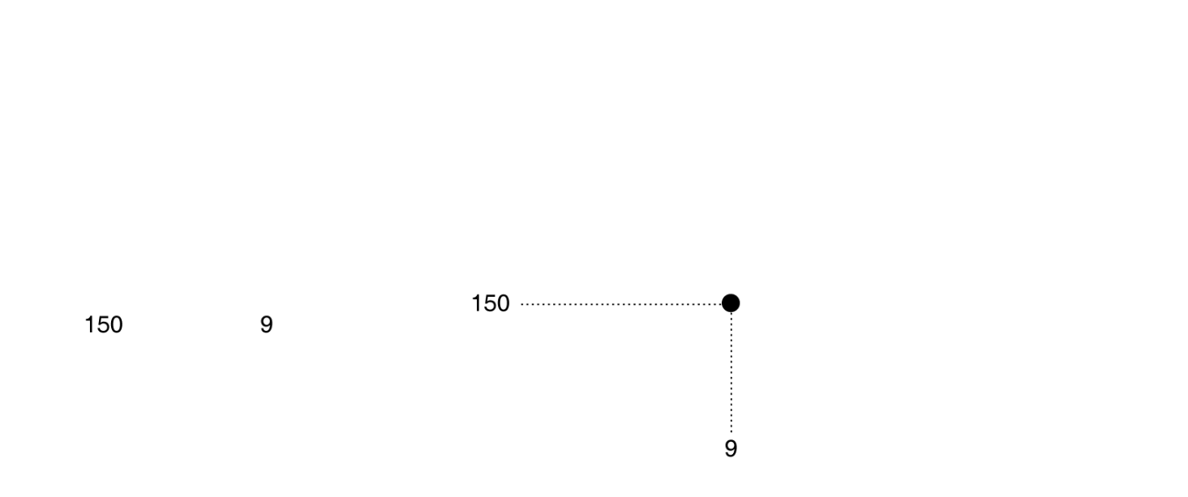
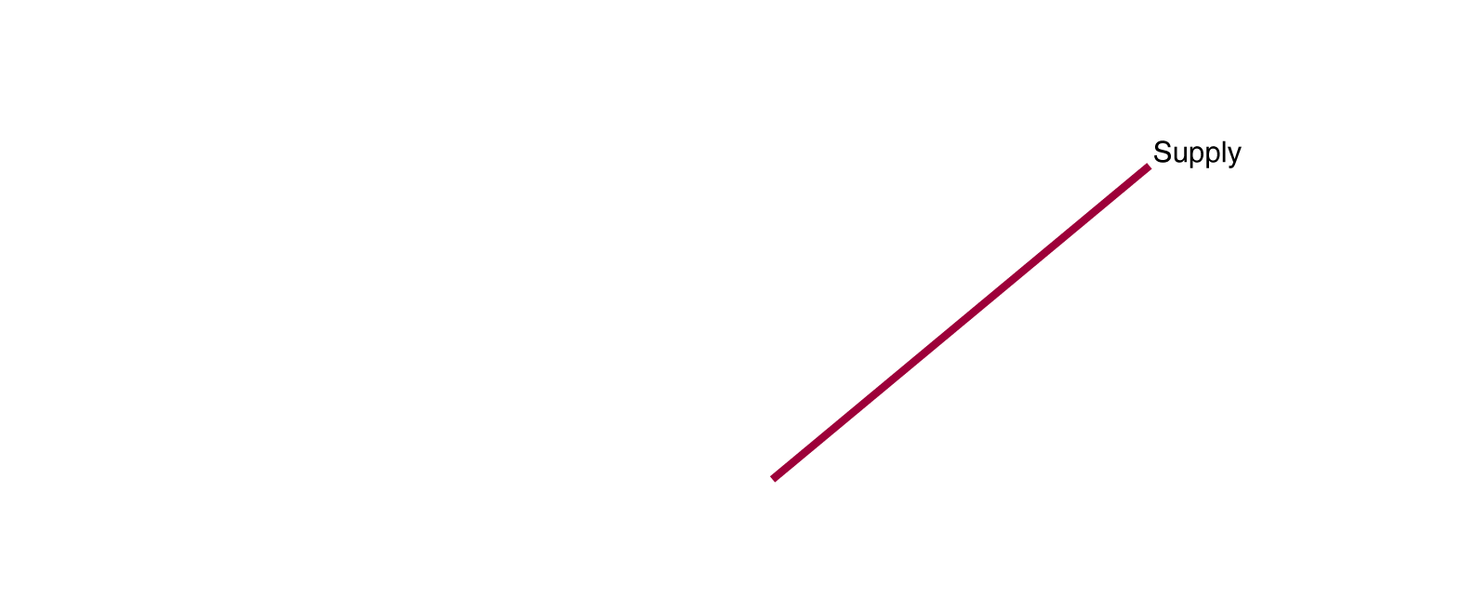
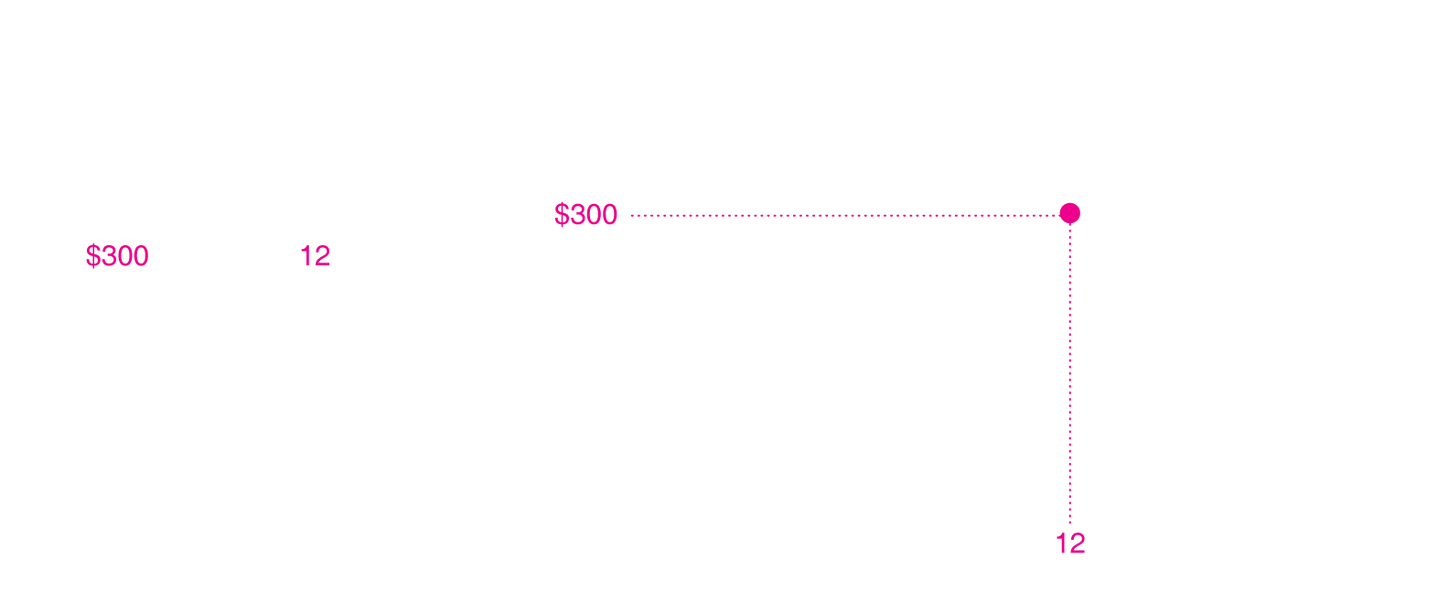
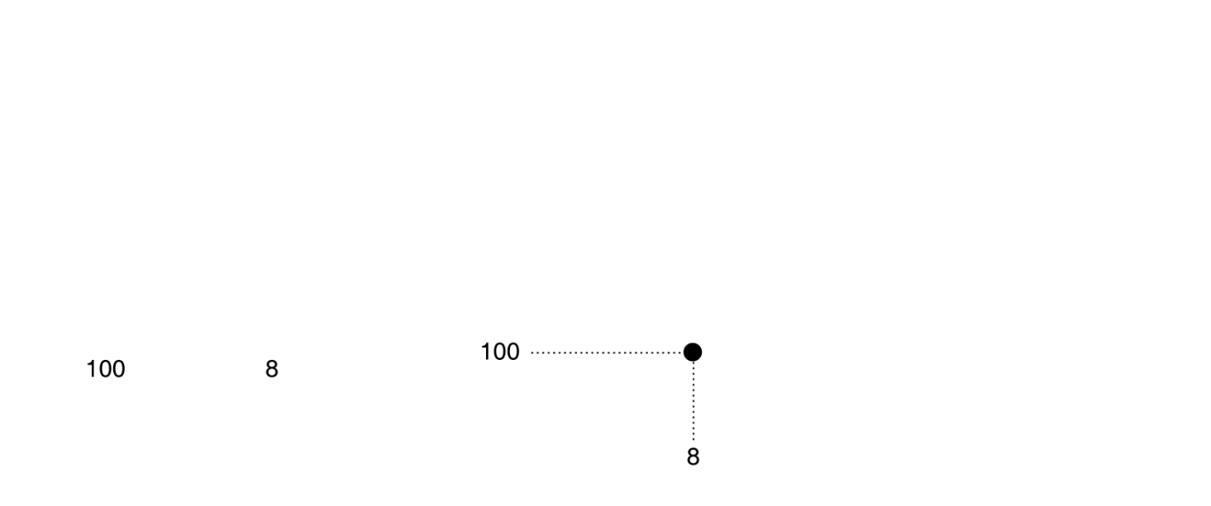
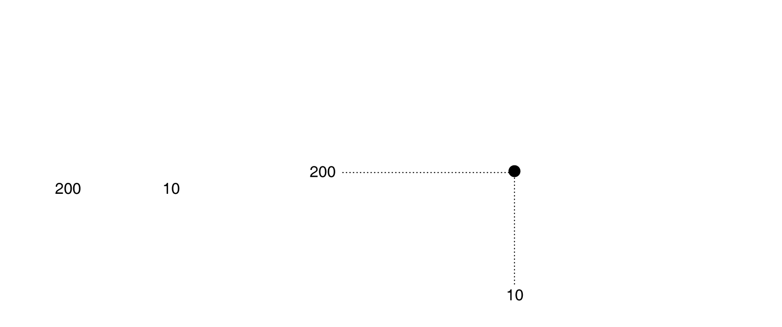
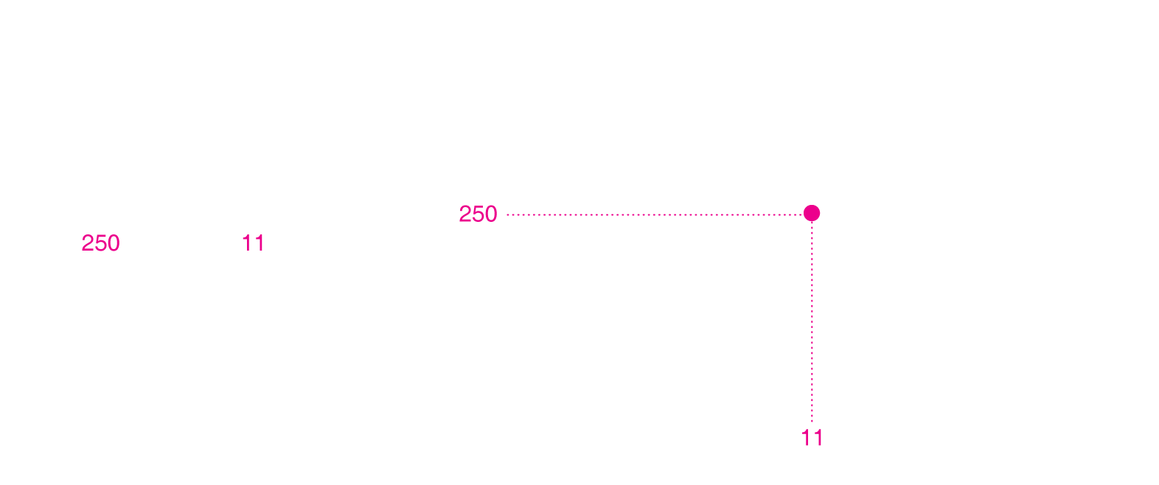
Supply Schedules and Supply Curves
Supply curve: A curve that shows the relationship between the price of a product and the quantity of the product supplied.
Notes:
As the price changes, Apple, Samsung, LG,
and other firms producing smartphones
change the quantity they are willing to supply.
We can show this as a supply schedule
in a table or as a supply curve on a graph.
The supply schedule and supply curve both
show that as the price of smartphones rises,
firms will increase the quantity they supply.
At a price of $250 per smartphone, firms will
supply 11 million smartphones per week. At
a price of $300, firms will supply 12 million.

Slide 4
The Law of Supply
The law of supply: The rule that, holding everything else constant, increases in price cause increases in the quantity supplied, and decreases in price cause decreases in the quantity supplied.
Implication: supply curves slope upward.

Slide 5
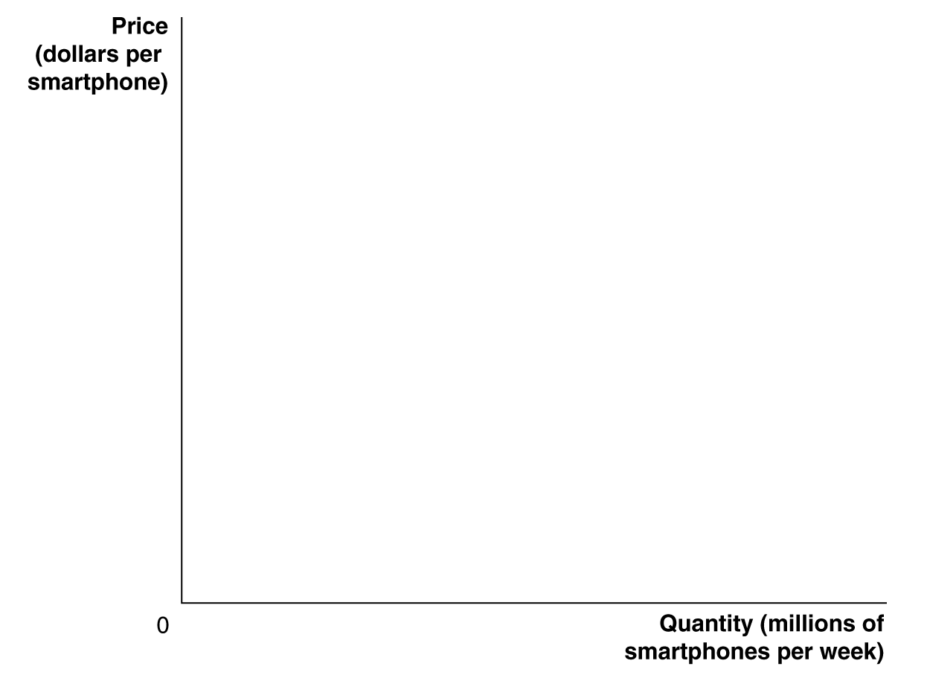
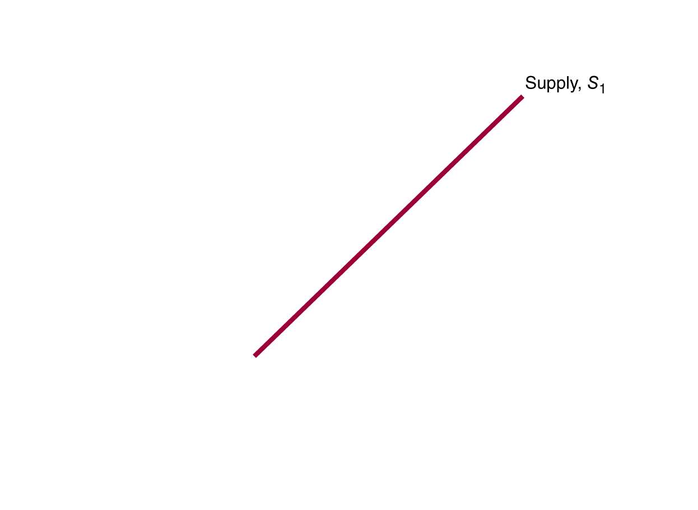
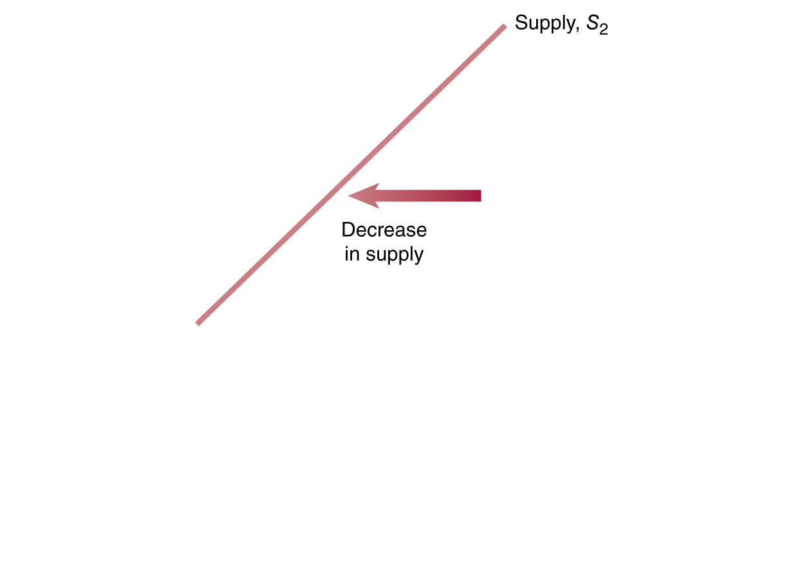
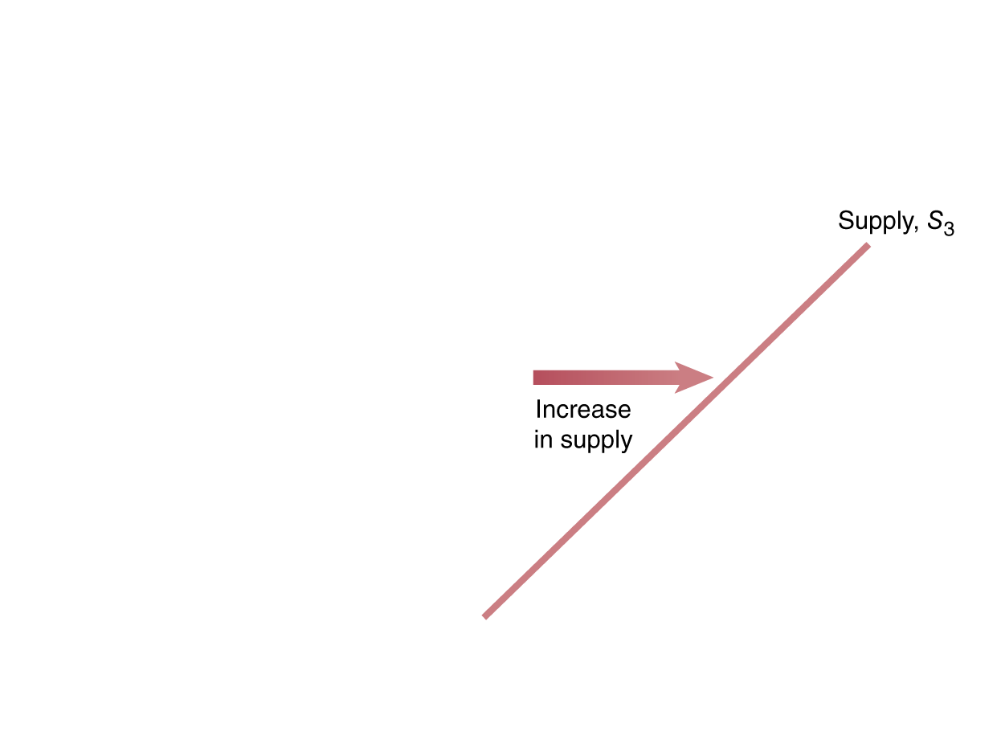
Increase and Decrease in Supply
A change in something other than price that affects supply causes the entire supply curve to shift.
A shift to the right (S₁ to S₃) is an increase in supply.
A shift to the left (S₁ to S₂) is a decrease in supply.
Shifting the supply curve
Notes:
When firms increase the quantity of a product
they want to sell at a given price, the
supply curve shifts to the right. The shift
from S1 to S3 represents an increase in supply.
When firms decrease the quantity of a
product they want to sell at a given price, the
supply curve shifts to the left. The shift from
S1 to S2 represents a decrease in supply.

Slide 6
Shifts of the Supply Curve
As the supply curve shifts, the quantity supplied will change, even if the price doesn’t change.
The quantity supplied changes at every possible price.
P₁
Q₂ Q₁ Q₃
Shifting the supply curve

Slide 7
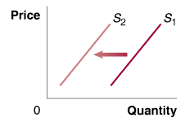
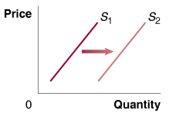
Changes in Prices of Inputs
Inputs are things used in the production of a good or service.
An increase in the price of an input decreases the profitability of selling the good, causing a decrease in supply.
A decrease in the price of an input increases the profitability of selling the good, causing an increase in supply.
Effect of an increase in the price of input goods
Effect of a decrease in the price of input goods

Slide 8
Technological Change
A firm may experience a positive or negative change in its ability to produce a given level of output with a given quantity of inputs. This is a technological change.
Changes raise or lower firms’ costs, hence their supply of the good.
Effect of a positive change in technology
Effect of a negative change in technology

Slide 9
Prices of Substitutes, and Number of Firms
Many firms can produce and sell more than one product.
Example:
An Illinois farmer can plant corn or soybeans. If the price of soybeans rises, he will plant (supply) less corn.
More firms in the market will result in more product available at a given price (greater supply).
Fewer firms → supply decreases.
Effect on the supply of corn, of an increase in the price of soybeans
Effect of a increase in the number of firms

Slide 10
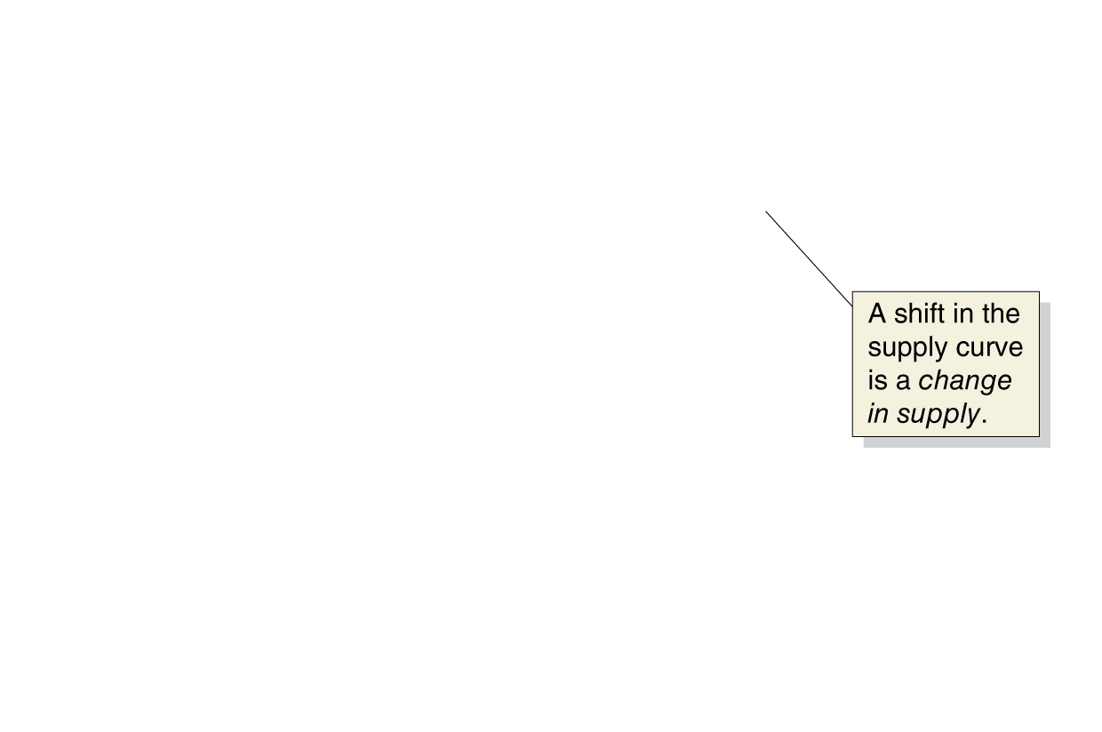
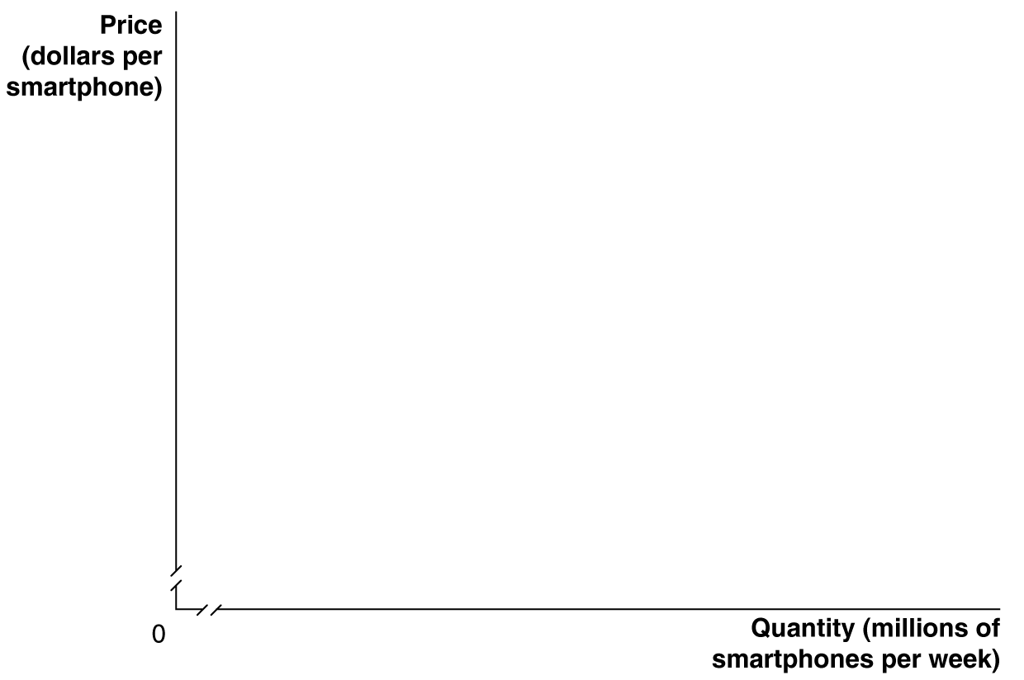
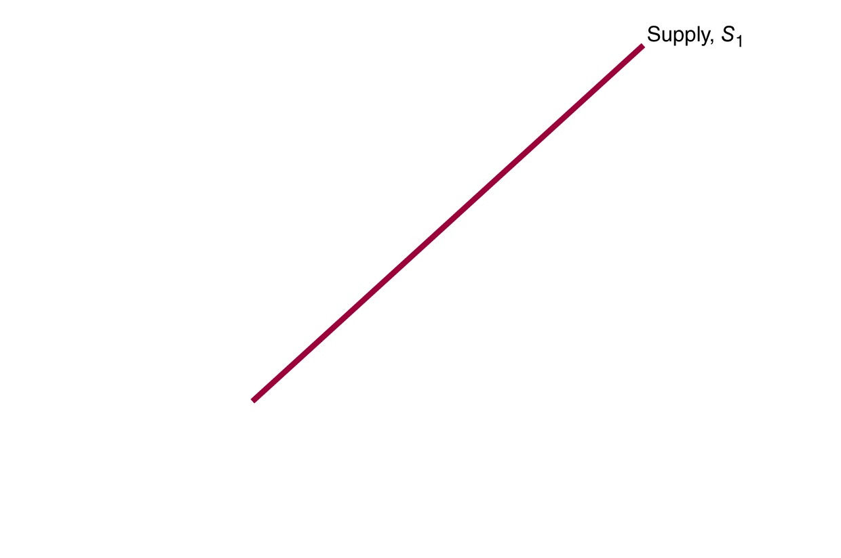
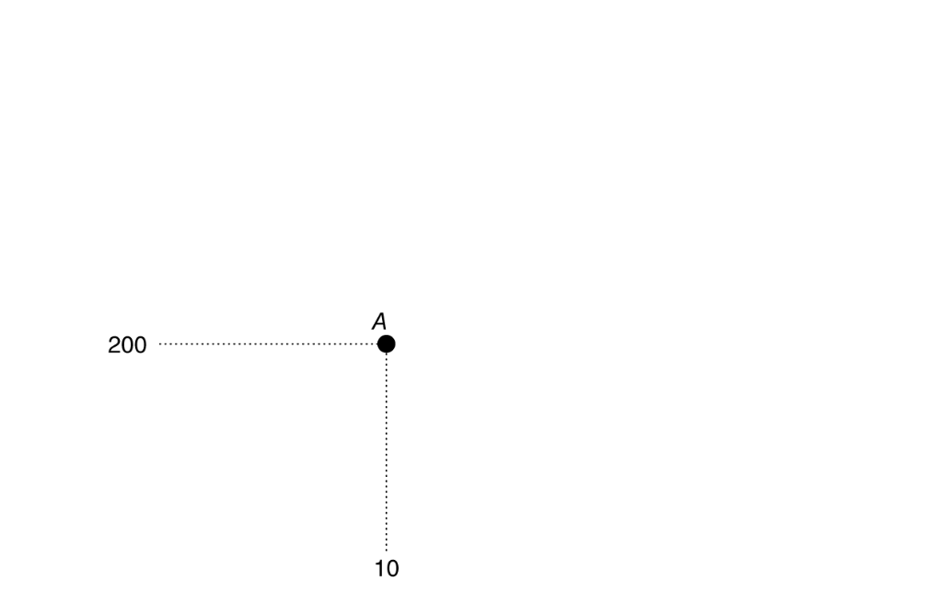
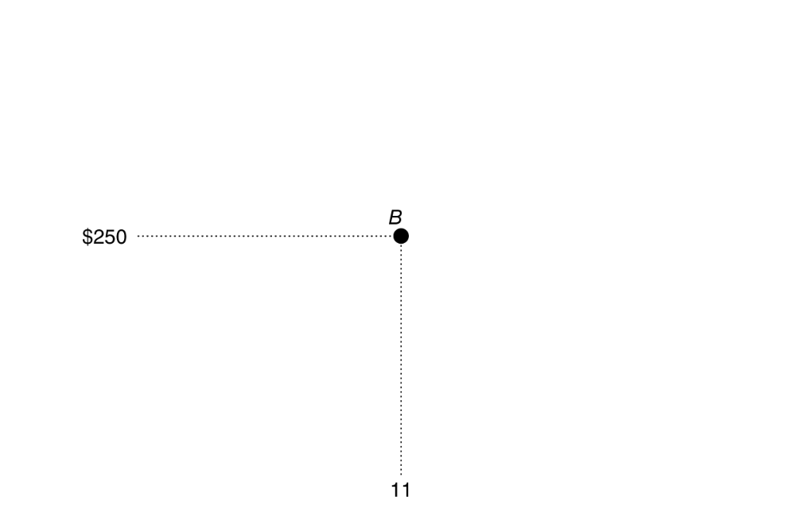

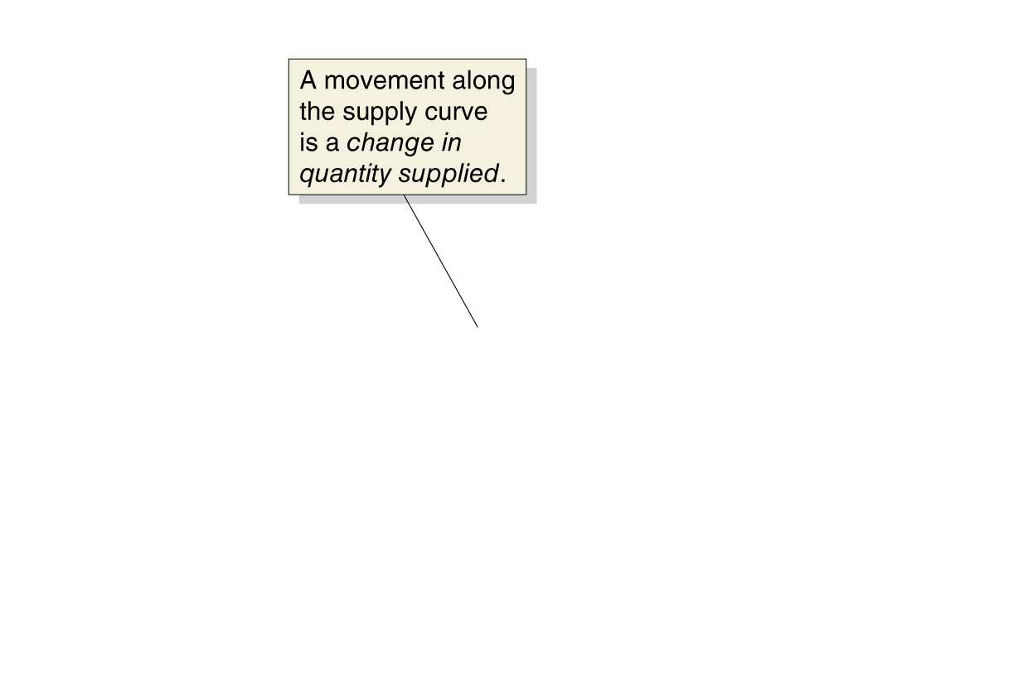
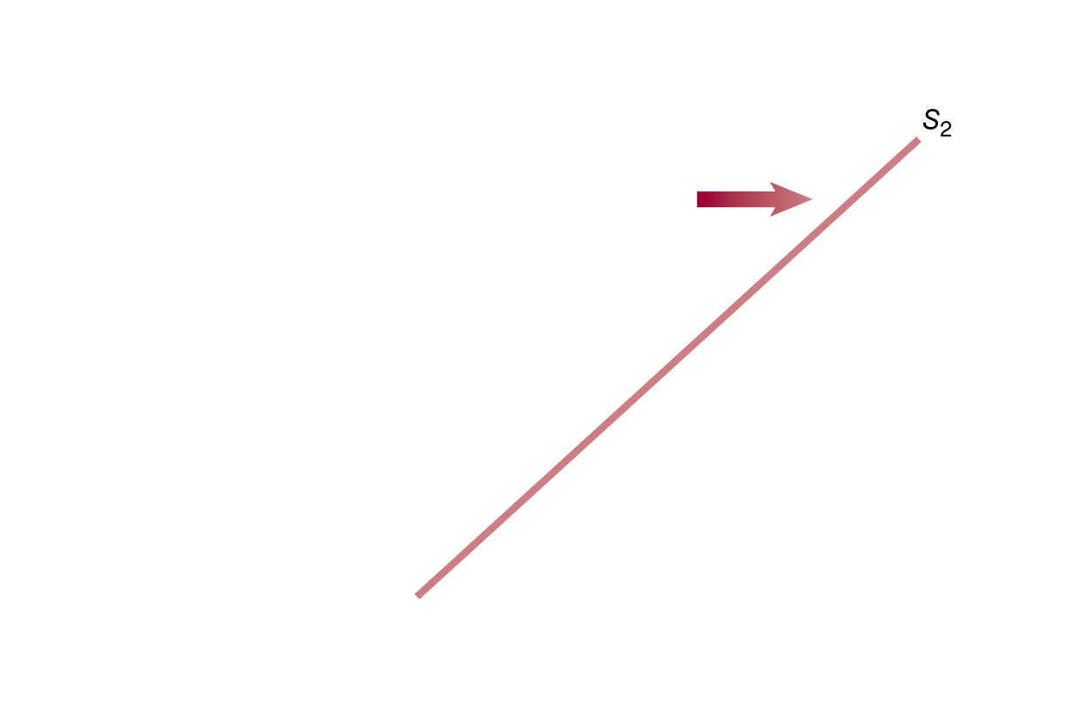
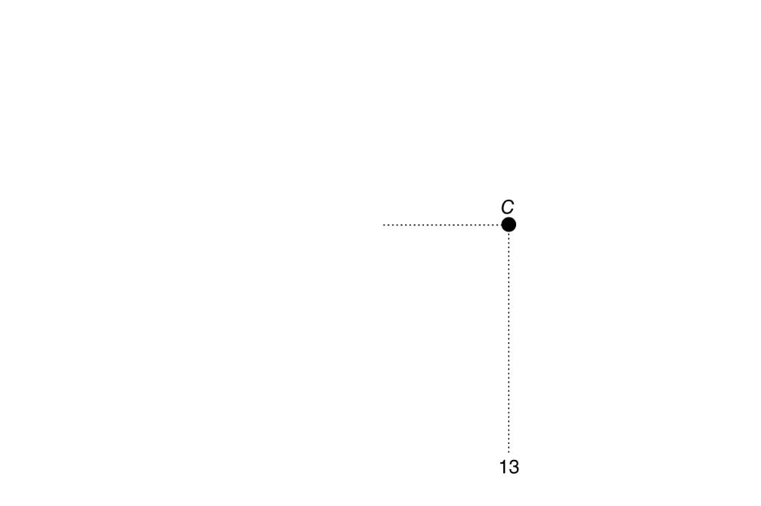
Change in Supply vs. Change in Quantity Supplied
A change in the price of the product being examined causes a movement along the supply curve.
This is a change in quantity supplied.
Any other change affecting supply causes the entire supply curve to shift.
This is a change in supply.
A change in supply versus a change in quantity supplied
Notes:
If the price of smartphones rises from $200
to $250, the result will be a movement up
the supply curve from point A to point B—
an increase in quantity supplied by Apple,
Samsung, Nokia, and other firms from
10 million to 11 million. If the price of an
input decreases, or if another factor changes
that causes sellers to supply more of the
product at every price, the supply curve will
shift to the right—an increase in supply. In
this case, the increase in supply from S1 to S2
causes the quantity of smartphones supplied
at a price of $250 to increase from 11 million
at point B to 13 million at point C.

Slide 11
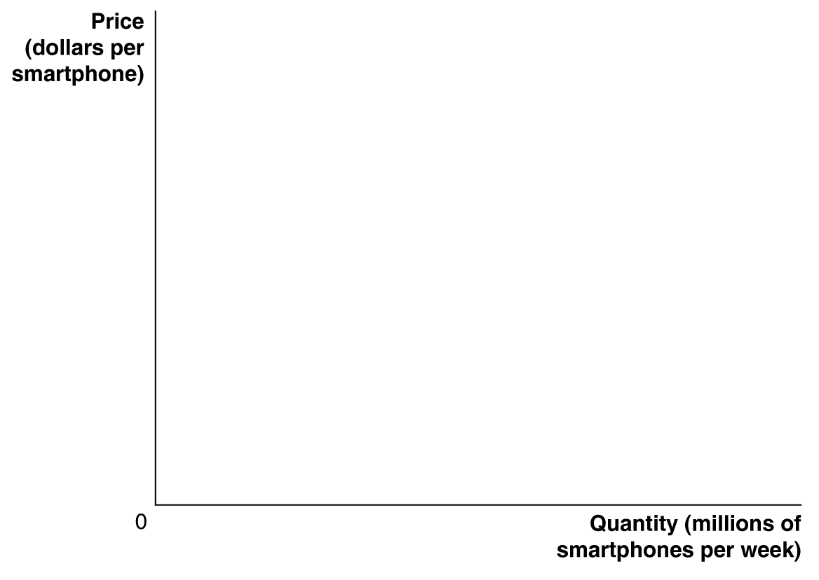
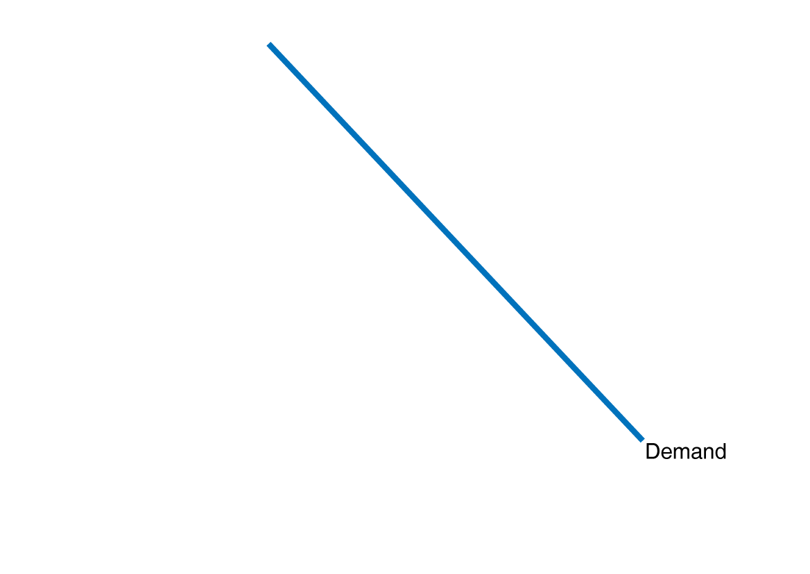
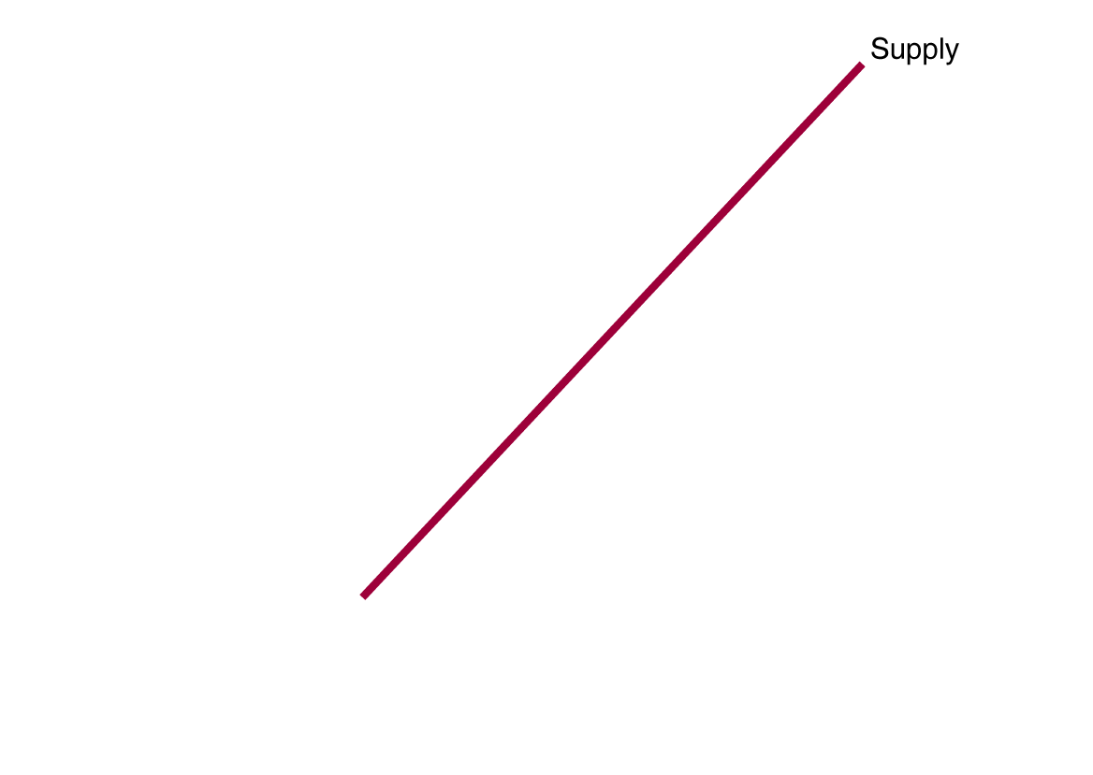
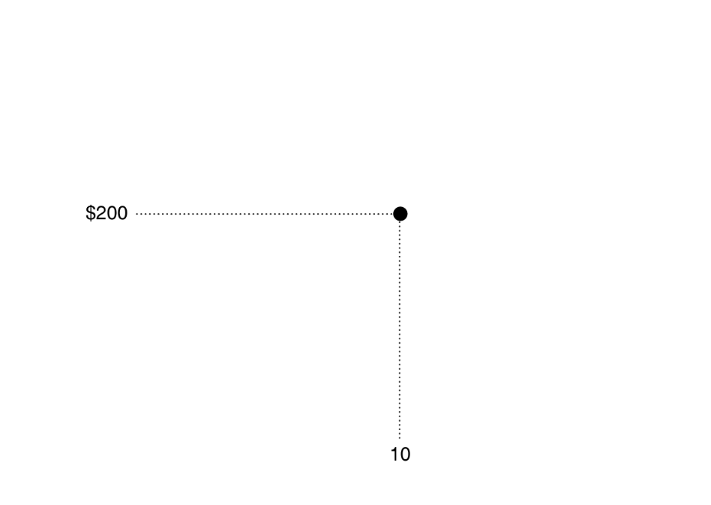
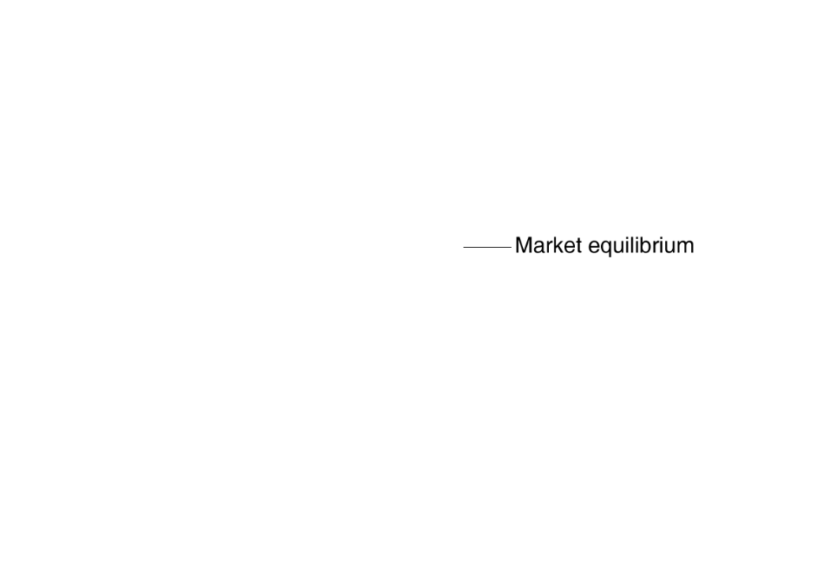
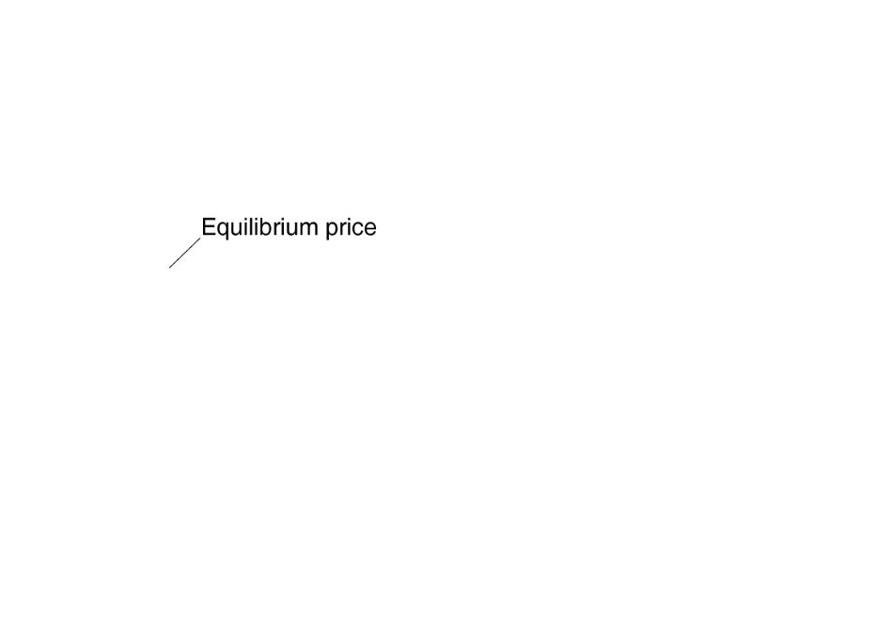
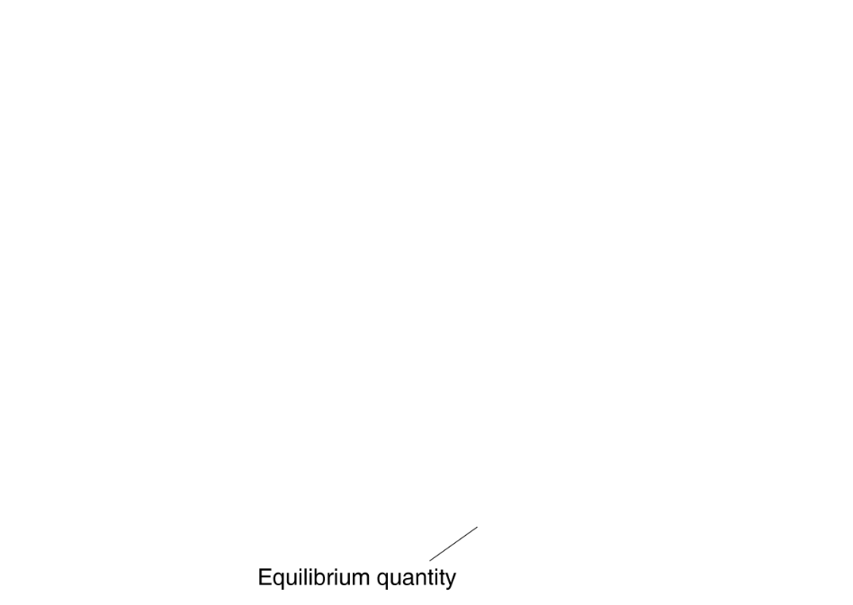
Market Equilibrium Price and Quantity
In this market:
The equilibrium price of a smartphone is $200, and
The equilibrium quantity of a smartphone is 10 million smartphones per week.
Since buyers and sellers want to trade the same quantity at the price of $200, we do not expect the price to change.
Market equilibrium

Slide 12
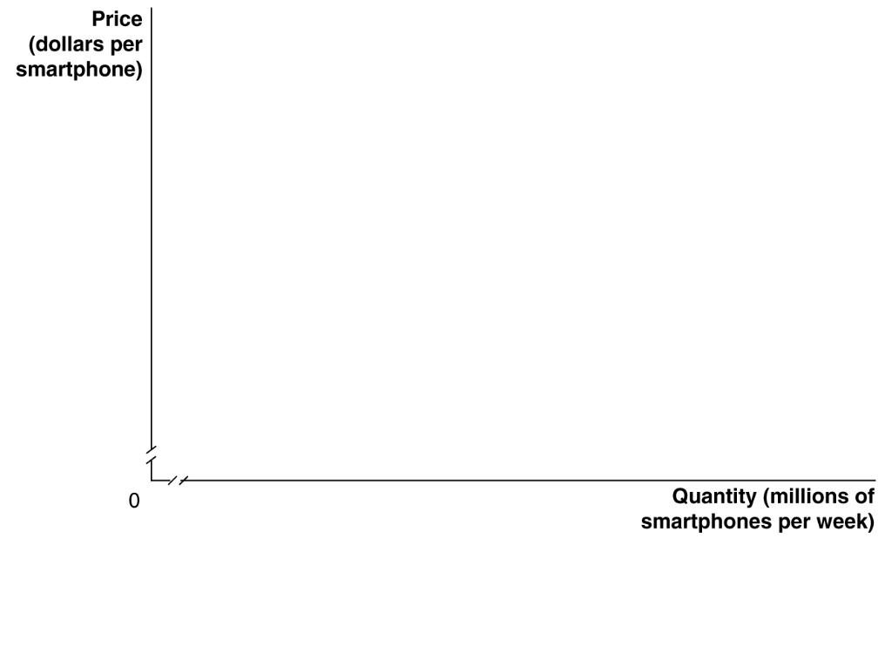
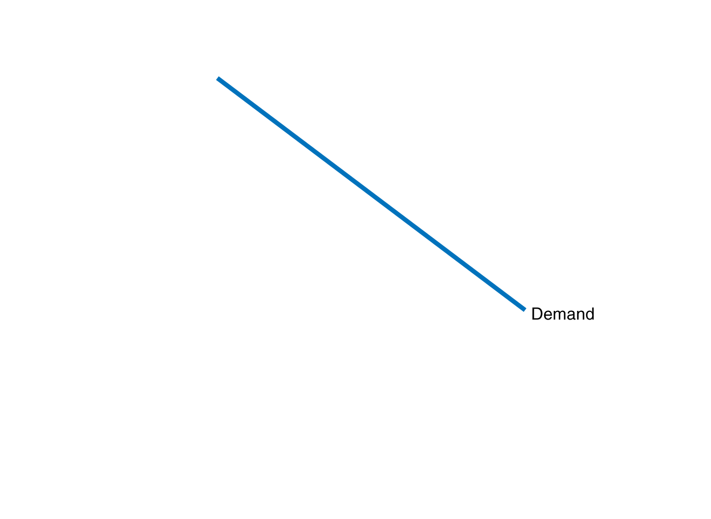
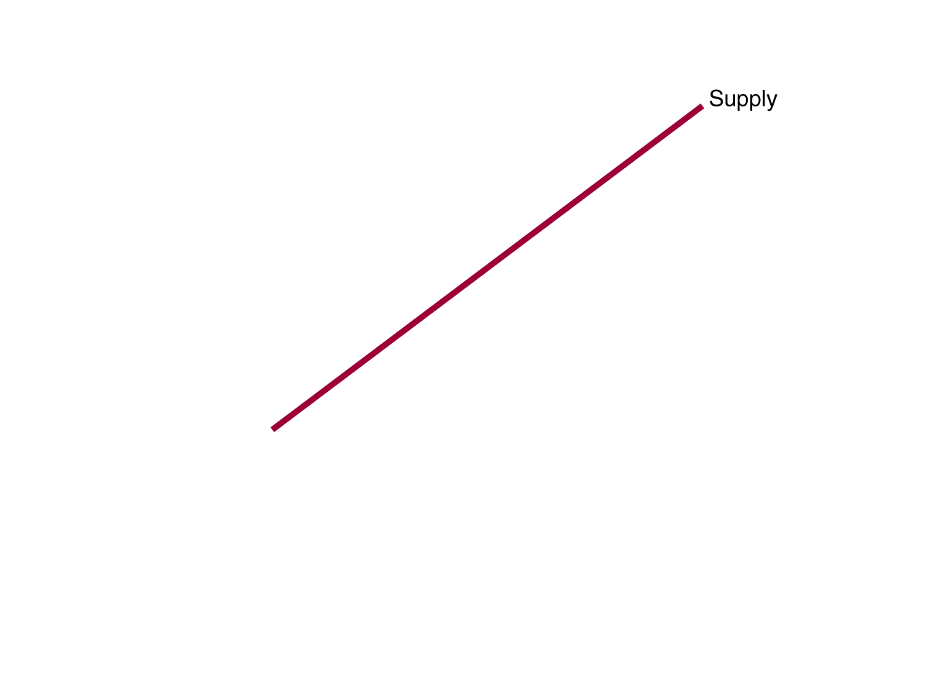
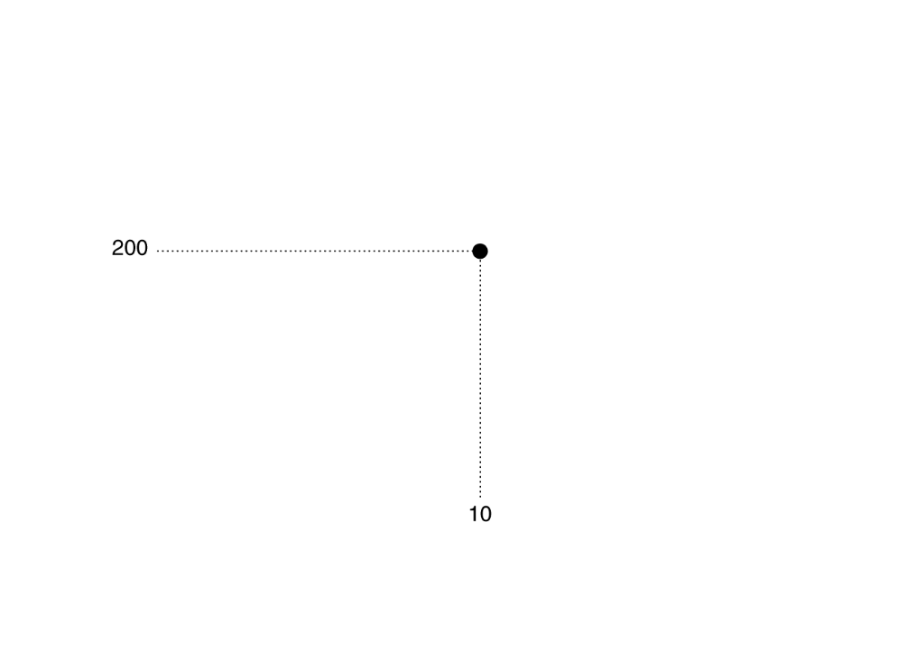
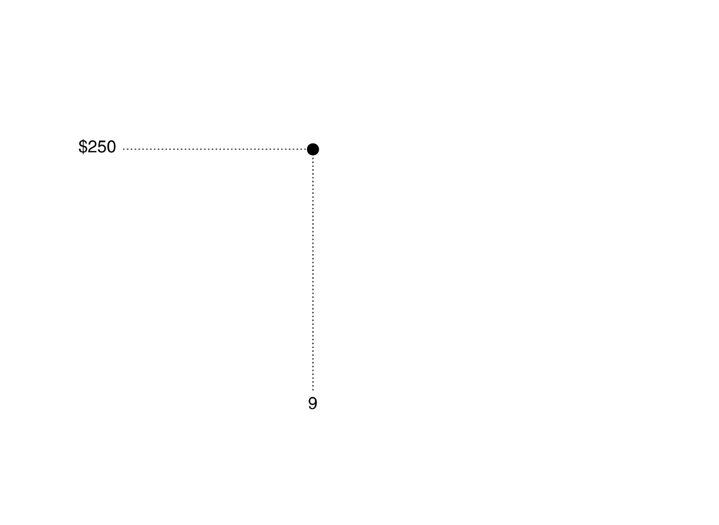
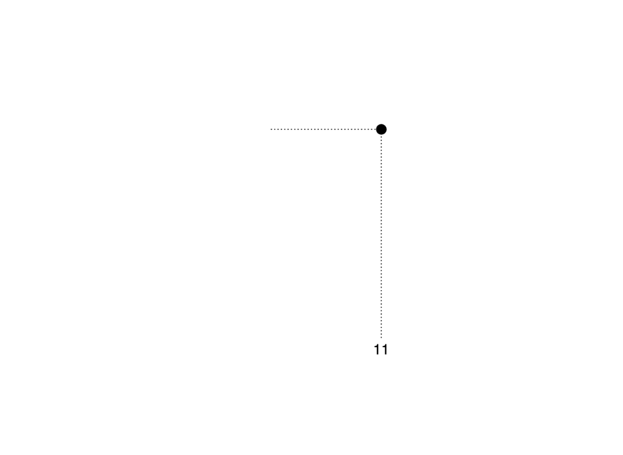
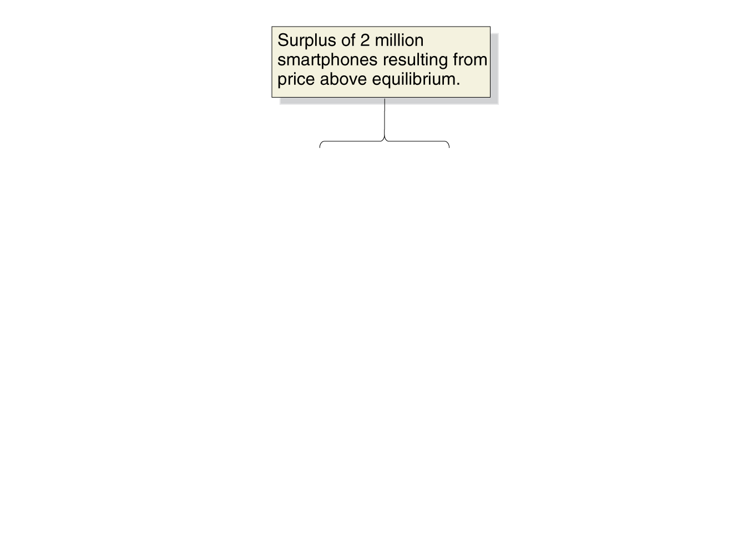
A Surplus in the Market for Smartphones
At a price of $250,
Qd= 9 million
But…
Qs=11 million
This gives a surplus of 2 million smartphones: a situation in which quantity supplied is greater than quantity demanded.
What happens?
The effect of surpluses and shortages on the market price
Notes:
When the market price is above equilibrium,
there will be a surplus. A price of $250
for smartphones results in 11 million smartphones
being supplied but only 9 million
being demanded, or a surplus of 2 million.
As Apple, Nokia, LG, and other firms cut the
price to dispose of the surplus, the price will
fall to the equilibrium of $200. When the
market price is below equilibrium, there will
be a shortage. A price of $100 results in 12
million smartphones being demanded but
only 8 million being supplied, or a shortage
of 4 million. As firms find that consumers
who are unable to find smartphones available
for sale are willing to pay higher prices
to get them, the price will rise to the equilibrium
of $200.

Slide 13
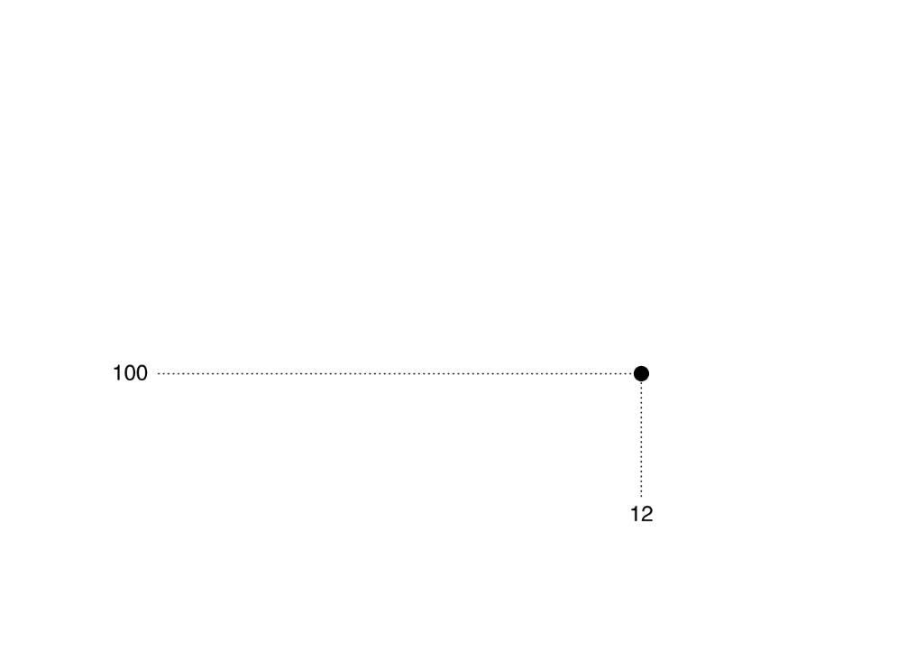
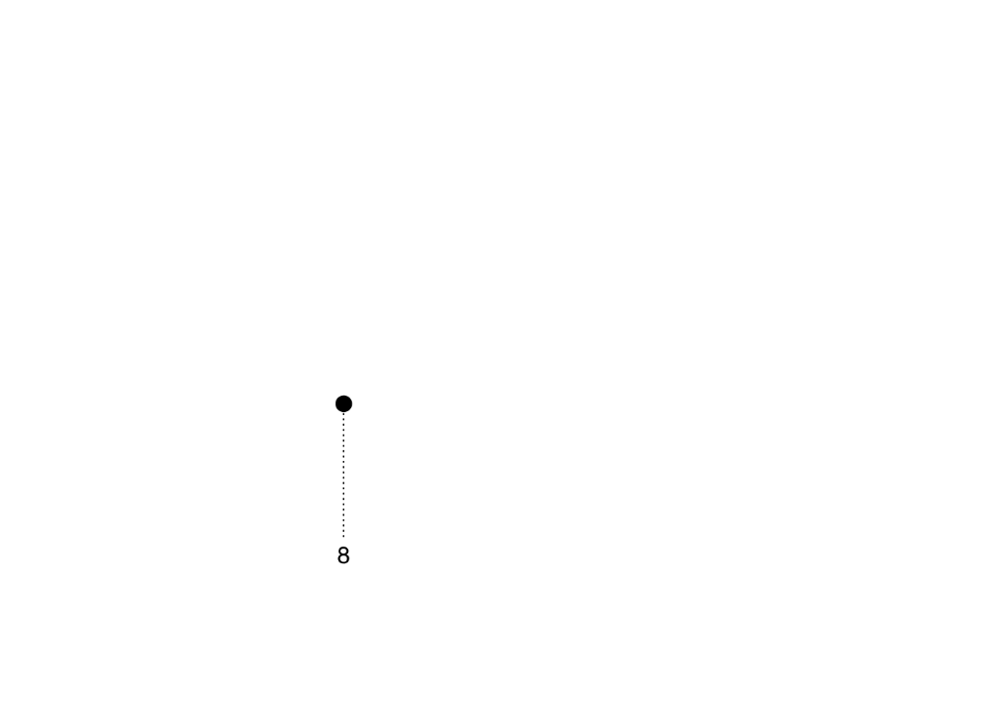
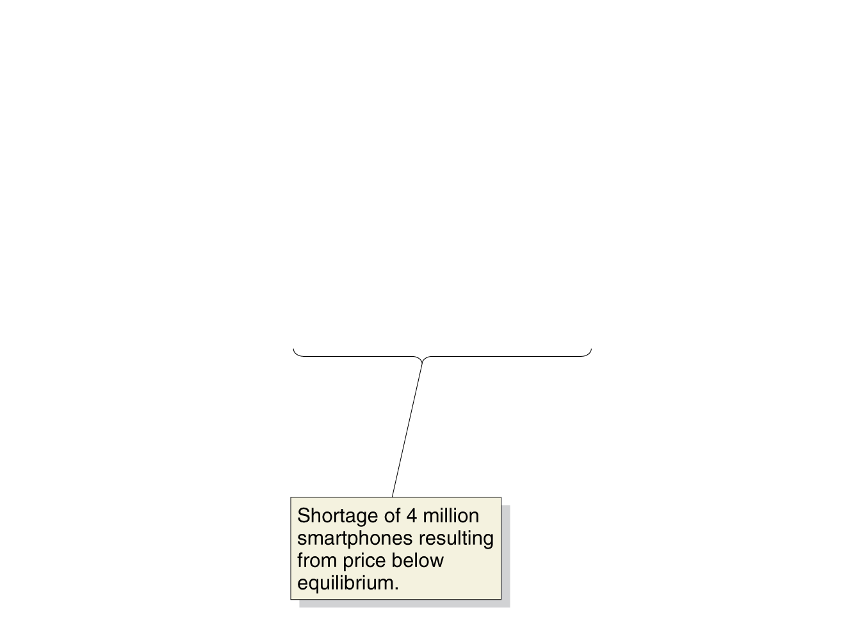
A Shortage in the Market for Smartphones
At a price of $100,
Qd=12 million
But…
Qs=8 million
This gives a shortage of 4 million smartphones: a situation in which quantity demanded is greater than quantity supplied.
What happens?
The effect of surpluses and shortages on the market price

Slide 14
Market Equilibrium
At a price of $200, Q_{s}=Q_{d}=10 million
This is a market equilibrium: a situation in which quantity demanded equals quantity supplied.
A market equilibrium with many buyers and sellers is a competitive market equilibrium.
Market equilibrium
Notes:
Where the demand curve crosses the supply
curve determines market equilibrium.
In this case, the demand curve for
smartphones crosses the supply curve at a
price of $200 and a quantity of 10 million
smartphones. Only at this point is the quantity
of smartphones consumers are willing
to buy equal to the quantity that Apple,
Samsung, LG, and other firms are willing to
sell: The quantity demanded is equal to the
quantity supplied.

Slide 15
Demand and Supply Both Count
Price is determined by the interaction of buyers and sellers.
Neither group can dictate price in a competitive market (i.e. one with many buyers and sellers).
However changes in supply and/or demand will affect the price and quantity traded.

Slide 16
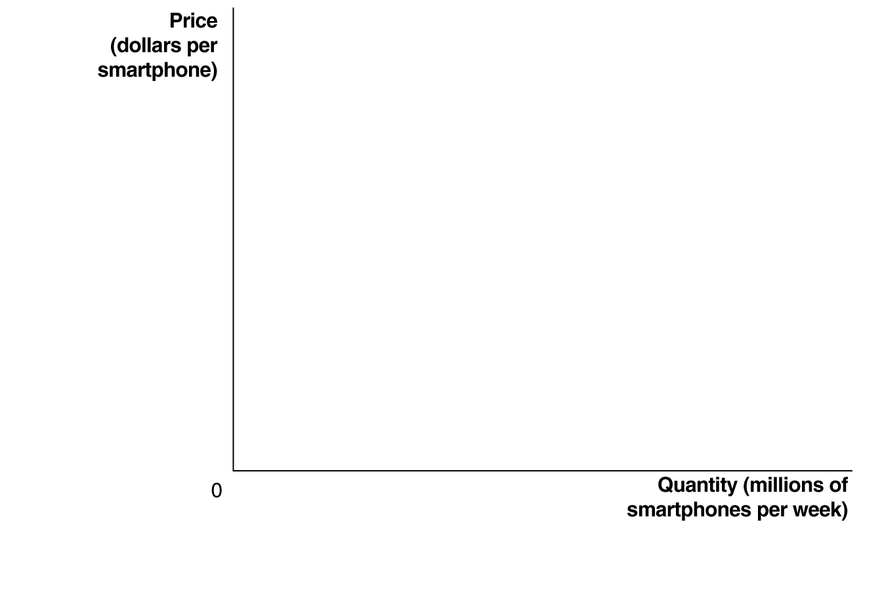
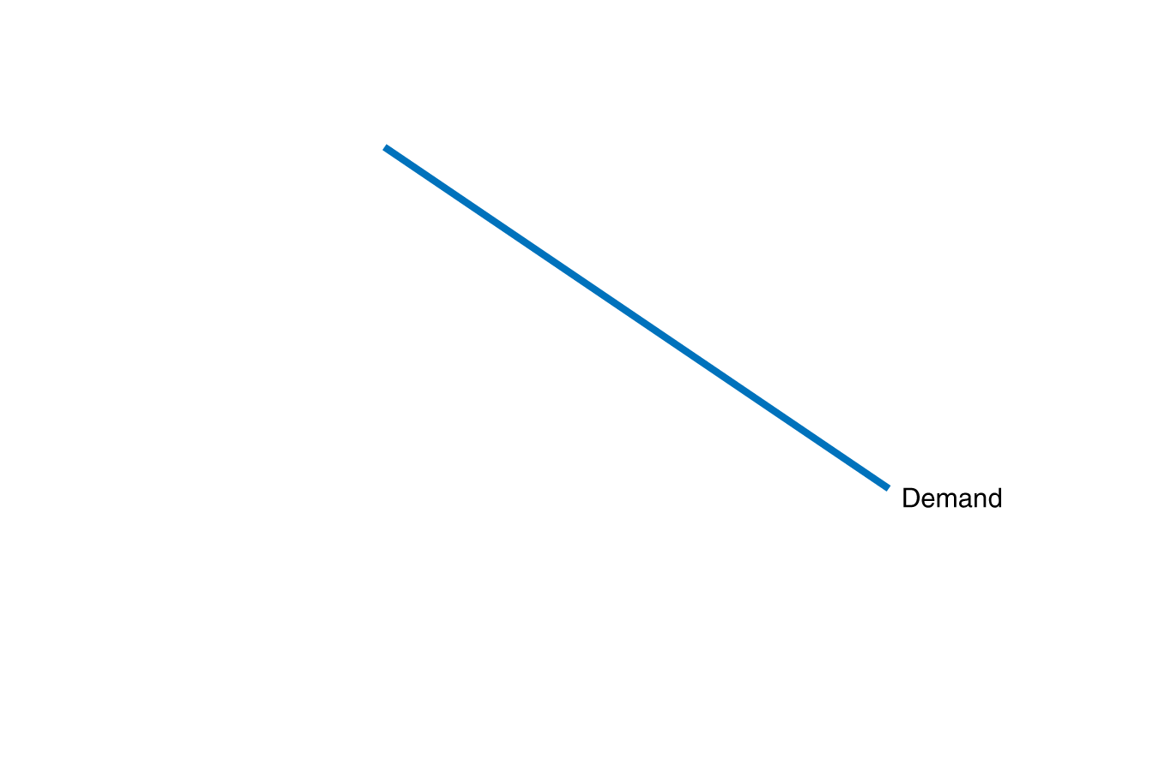
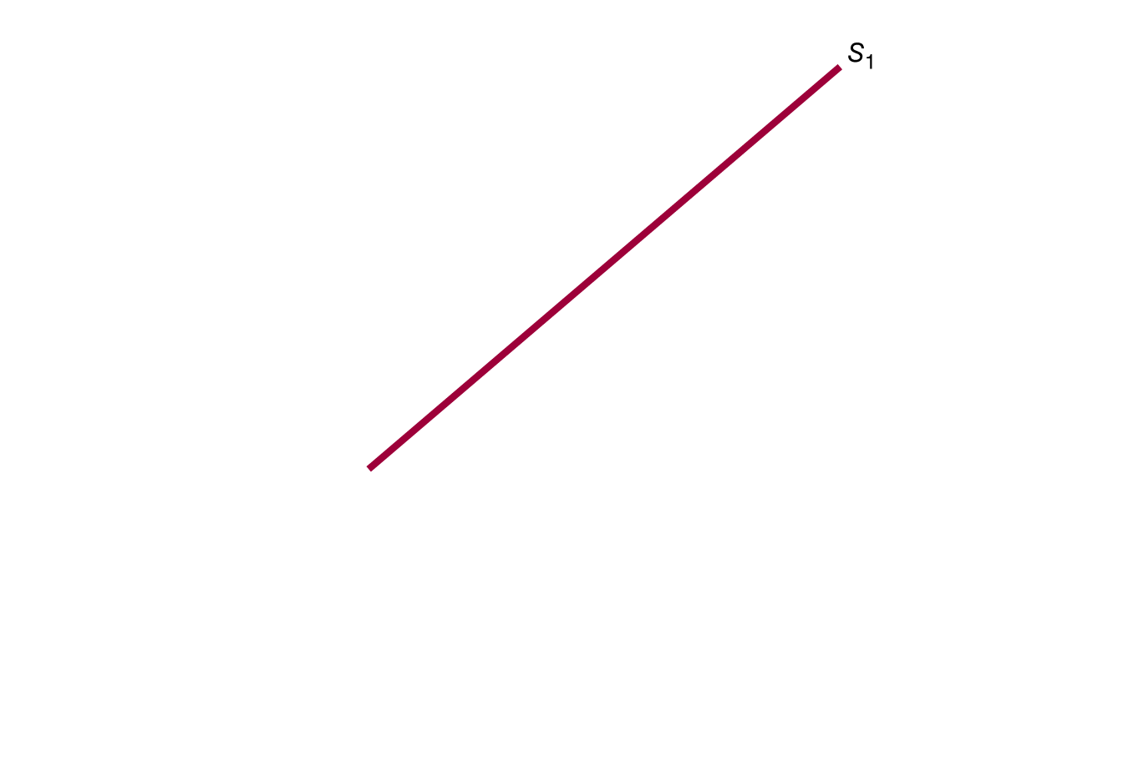
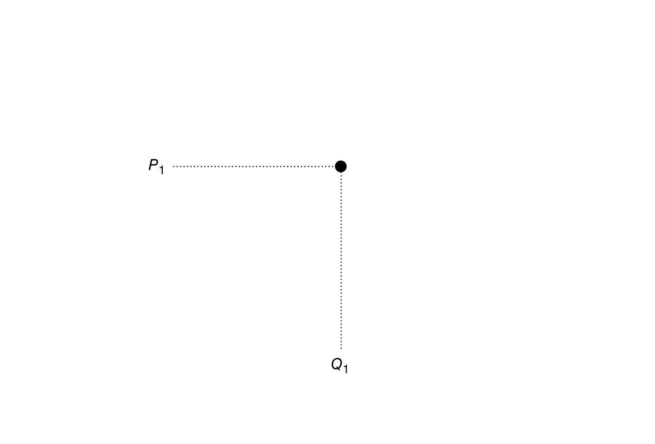
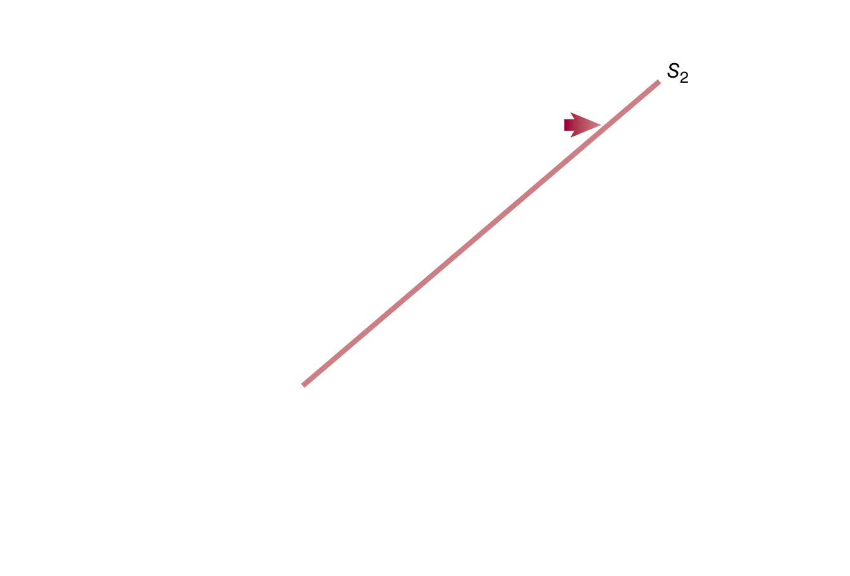
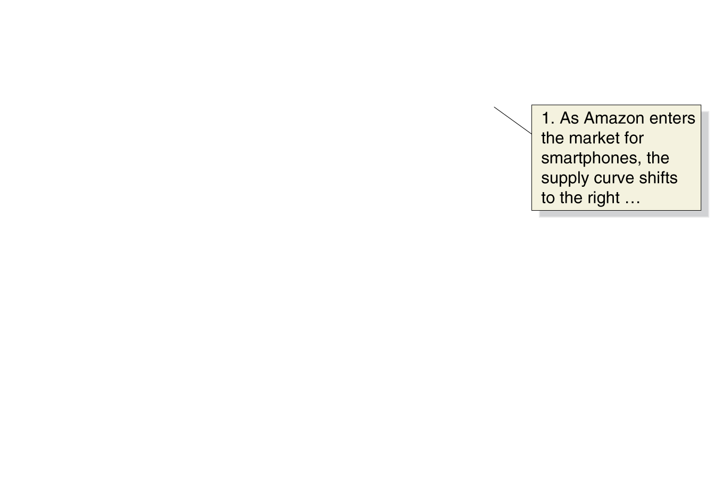
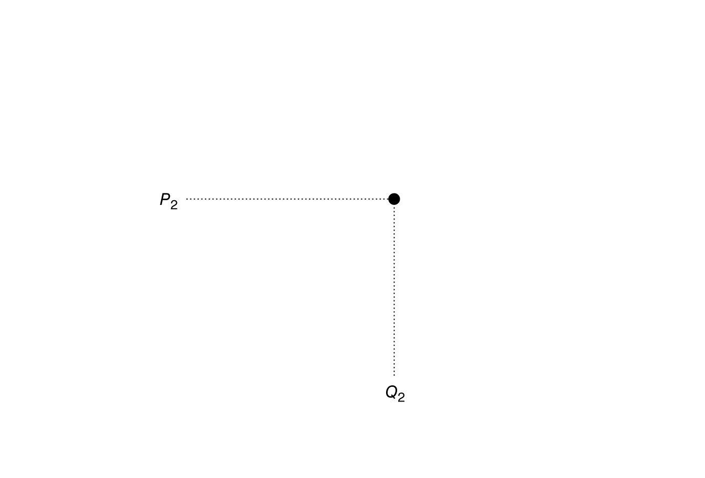
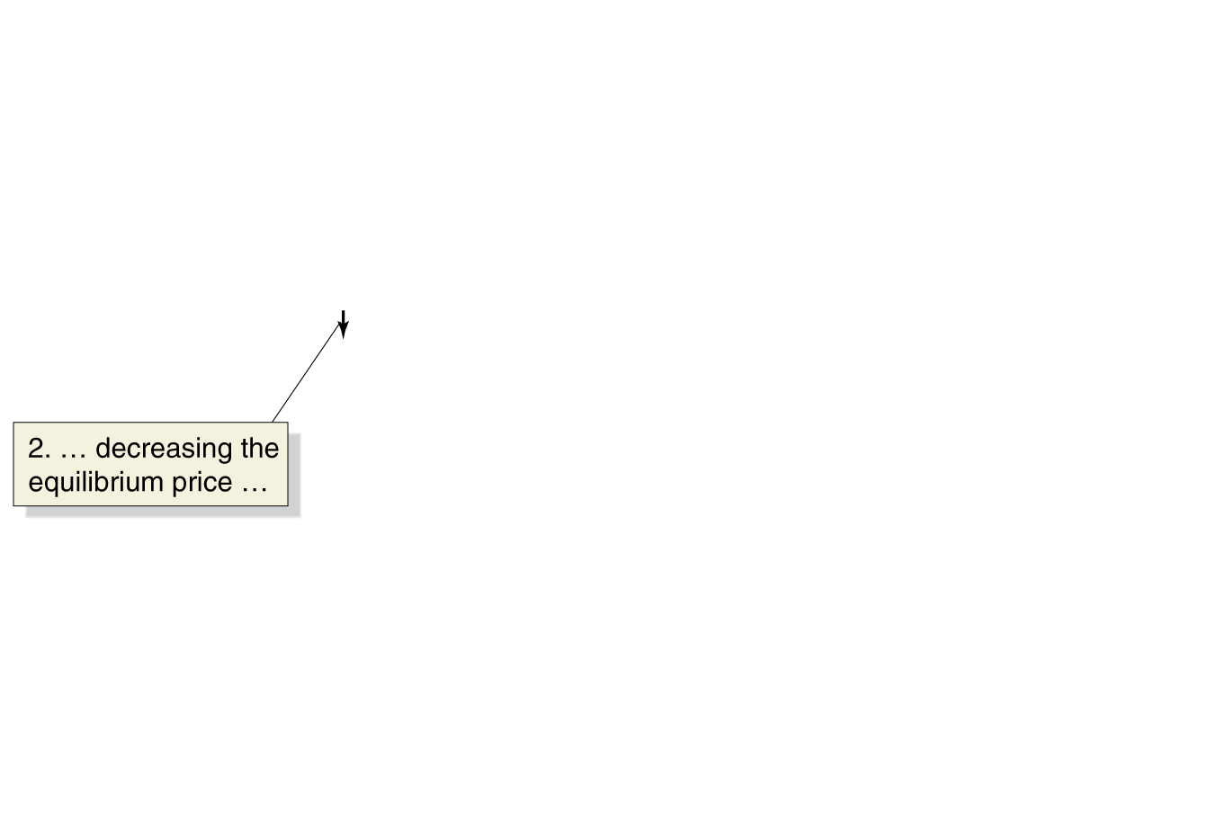
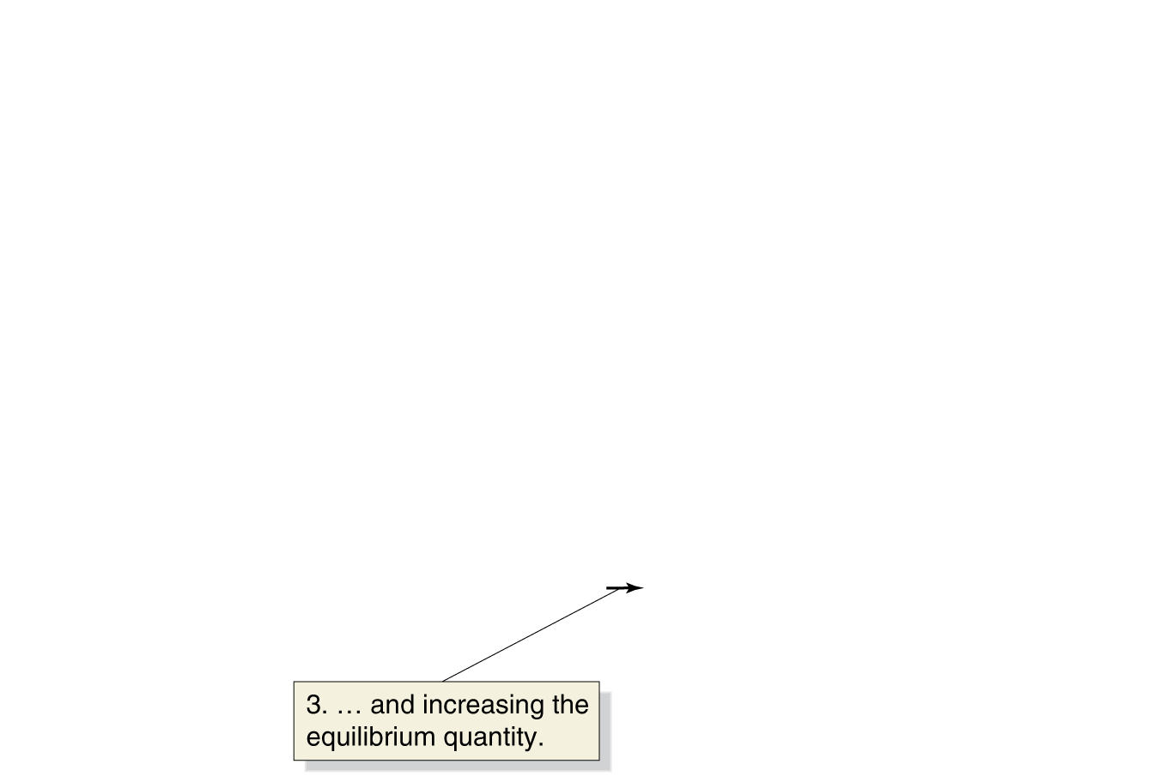
The Effect of Shifts in Supply on Equilibrium
Amazon enters the smartphone market:
More smartphones are supplied at any given price—an increase in supply from S₁ to S₂.
→Equilibrium price falls from P₁ to P₂.
→Equilibrium quantity rises from Q₁ to Q_{2.}
The effect of an increase in supply on equilibrium
Notes:
If a firm enters a market, as Amazon is
expected to enter the market for smartphones,
the equilibrium price will fall, and
the equilibrium quantity will rise:
1. As Amazon enters the market for
smartphones, a larger quantity of
smartphones will be supplied at every
price, so the market supply curve shifts
to the right, from S1 to S2, which causes
a surplus of smartphones at the original
price, P1.
2. The equilibrium price falls from P1 to P2.
3. The equilibrium quantity rises from Q1
to Q2.

Slide 17
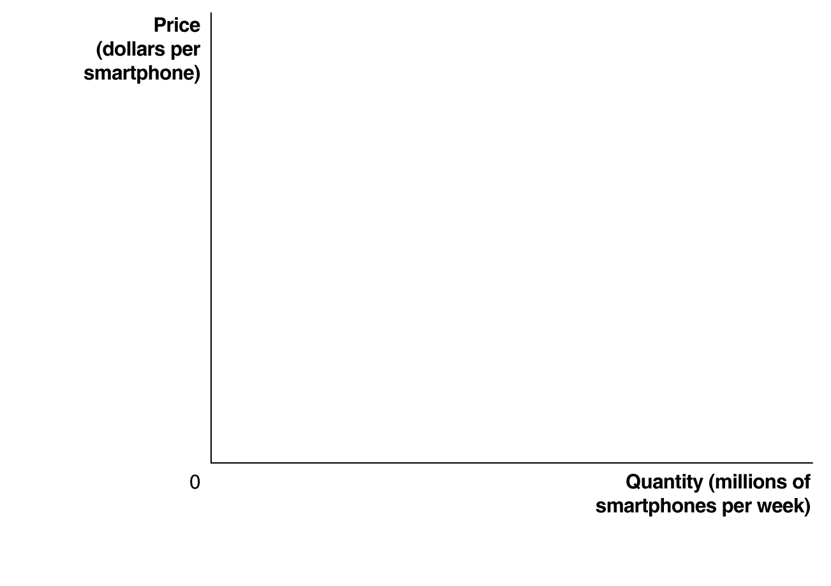








The Effect of Shifts in Demand on Equilibrium
Suppose incomes increase?
Smartphones are a normal good, so demand shifts to the right (D₁ to D₂).
→ Equilibrium price rises (P₁ to P₂).
→Equilibrium quantity rises (Q₁ to Q₂).
The effect of an increase in demand on equilibrium
Notes:
Increases in income will cause the equilibrium
price and quantity to rise:
1. Because smartphones are a normal
good, as income increases, the quantity
demanded increases at every price, and
the market demand curve shifts to the
right, from D1 to D2, which causes a
shortage of smartphones at the original
price, P1.
2. The equilibrium price rises from P1 to P2.
3. The equilibrium quantity rises from Q1
to Q2.

Slide 18
How Much Will Price and Quantity Change?
By how much will price fall? By how much will quantity rise?
For now, we cant predict that.
The effect of an increase in supply on equilibrium

Slide 19








Shifts in Demand and Supply over Time
What happens in the long run?
As new firms enter the market for smartphones and incomes increase, we expect:
The supply of smartphones will shift to the right, and
The demand for smartphones will shift to the right.
Shifts in demand and supply over time: demand shifting more than supply
Notes:
Whether the price of a product rises or falls over time depends on whether demand
shifts to the right more than supply.
In panel (a), demand shifts to the right more than supply, and the equilibrium
price rises:
1. Demand shifts to the right more than supply.
2. The equilibrium price rises from P1 to P2.
In panel (b), supply shifts to the right more than demand, and the equilibrium
price falls:
1. Supply shifts to the right more than demand.
2. The equilibrium price falls from P1 to P2.

Slide 20
Find the quantity demanded and quantity supplied at a price of $1, then quantify the excess demand (shortage).
Price | Qty Supplied | Qty Demanded
1 | 130 | 280
2 | 260 | 260
3 | 390 | 240
4 | 520 | 220
5 | 650 | 200
6 | 780 | 180
7 | 910 | 160
8 | 1040 | 140
The shortage is equal to:
400
300
150
0

Slide 21
Find the quantity demanded and quantity supplied at a price of $1, then quantify the excess demand (shortage).
Price | Qty Supplied | Qty Demanded
1 | 130 | 280
2 | 260 | 260
3 | 390 | 240
4 | 520 | 220
5 | 650 | 200
6 | 780 | 180
7 | 910 | 160
8 | 1040 | 140
The shortage is equal to:
280-130=150

Slide 22

Notes:
Poll Title: Is there a possible equilibrium price in this market? If so, what is it? https://www.polleverywhere.com/multiple_choice_polls/GWmKsvj0le7pX25j0EDv6

Slide 23
Is there a possible equilibrium price in this market? If so, what is it?
Price | Qty Supplied | Qty Demanded
1 | 130 | 280
2 | 260 | 260
3 | 390 | 240
4 | 520 | 220
5 | 650 | 200
6 | 780 | 180
7 | 910 | 160
8 | 1040 | 140

Slide 24
Is there a possible equilibrium price in this market? If so, what is it?
Equilibrium price = $2
Equ. Quantity=260
Price | Qty Supplied | Qty Demanded
1 | 130 | 280
2 | 260 | 260
3 | 390 | 240
4 | 520 | 220
5 | 650 | 200
6 | 780 | 180
7 | 910 | 160
8 | 1040 | 140

Slide 25

Notes:
Poll Title: Use the following equations for the supply and demand of hockey sticks to find the equilibrium quantity Q*. P=50−4QD /P=10+4QS https://www.polleverywhere.com/multiple_choice_polls/ucLGrSv0jXwD71Q

Slide 26
Use the following equations for the supply and demand of hockey sticks to find the equilibrium quantity Q*.
P=50−4Q
P=10+4Q
(Make sure you know which is supply and which is demand!)
Q=5
Q=20
Q=30
Q=40

Slide 27
Use the following equations for the supply and demand of hockey sticks to find the equilibrium quantity Q*.
Demand: P=50−4Q 50-4Q=10+4Q
Supply: P=10+4Q 8Q=40
Q=5
P=50-4*5=30
P
$30
5
Q

